Slide 1
Vegetable Image Prediction
Done By: Toh Kien Yu (2222291)

Slide 2
Table Of Content
DevOps (Scrum Board and Branches)
Wireframes
Deep Learning Model Development
Web Application Development
Automatic Testing
MLOps CI/CD
Internet Deployment
Robotic Process Automation (RPA)

Slide 3
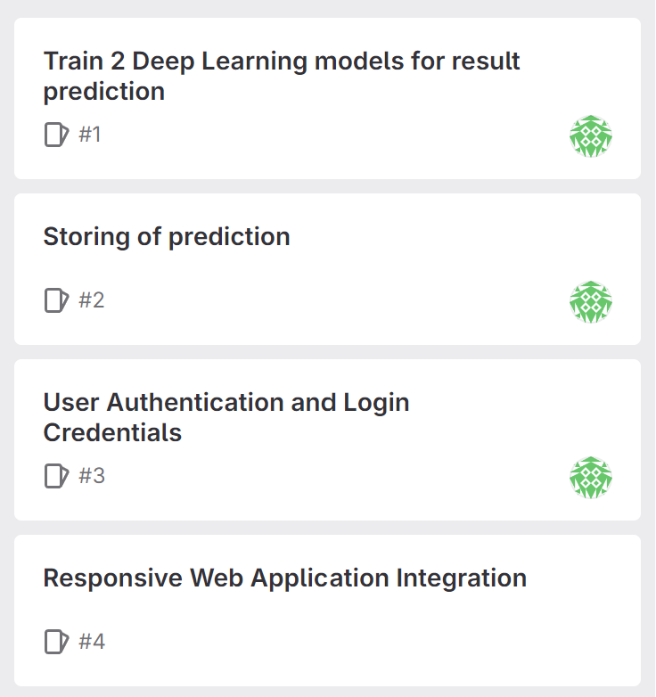
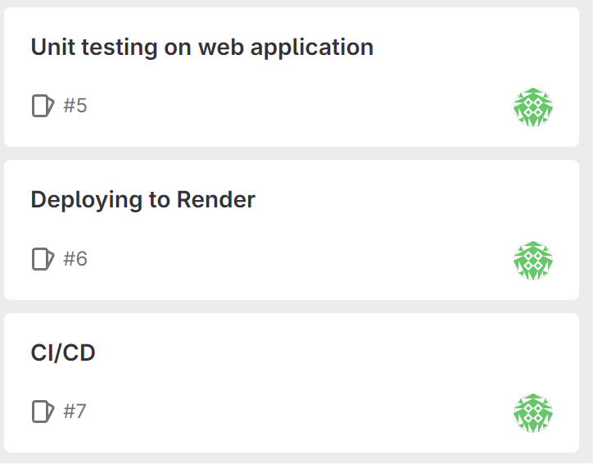
Scrum Board

Slide 4
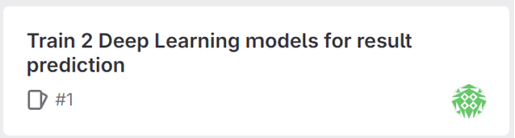
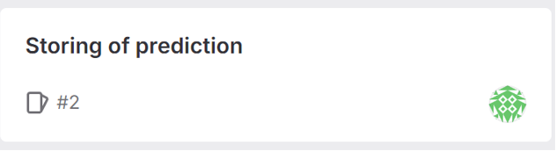

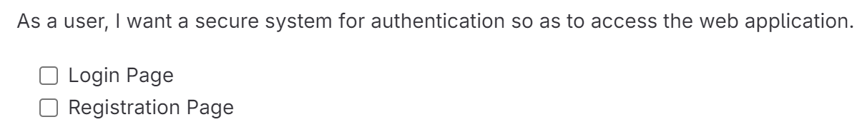
Scrum Board

Slide 5
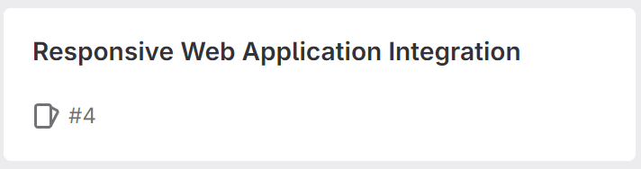
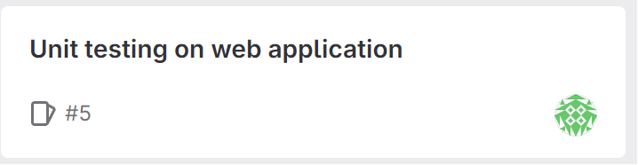
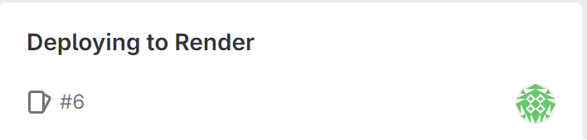
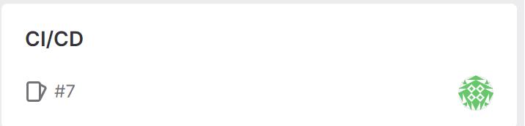
Scrum Board

Slide 6
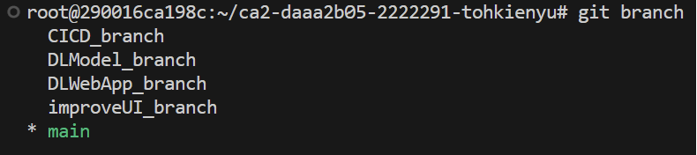
Branches
Branch 1: DLModel_branch
Focuses on the development and fine-tuning of Deep Learning models
Containerized the 2 best models into a single Docker container
Deploy Docker container to Render.com
Unit testing to ensure models are correctly that both models can be switched for inference within the web application
Branch 2: DLWebApp_branch
Integrate both models to web application for user to make predictions
Designing of user interface such as (login, register, prediction and prediction history page)
Unit testing
Branch 3: improveUI_branch
Make website responsive
Improve website user interface such as the layout, visuals and navigation.
Branch 4: CICD_branch
Focuses on automating the Continuous Integration and Continuous Deployment process for the web application.
Setting up of automated pipelines for testing and deployment ensuring efficient delivery of updates

Slide 7
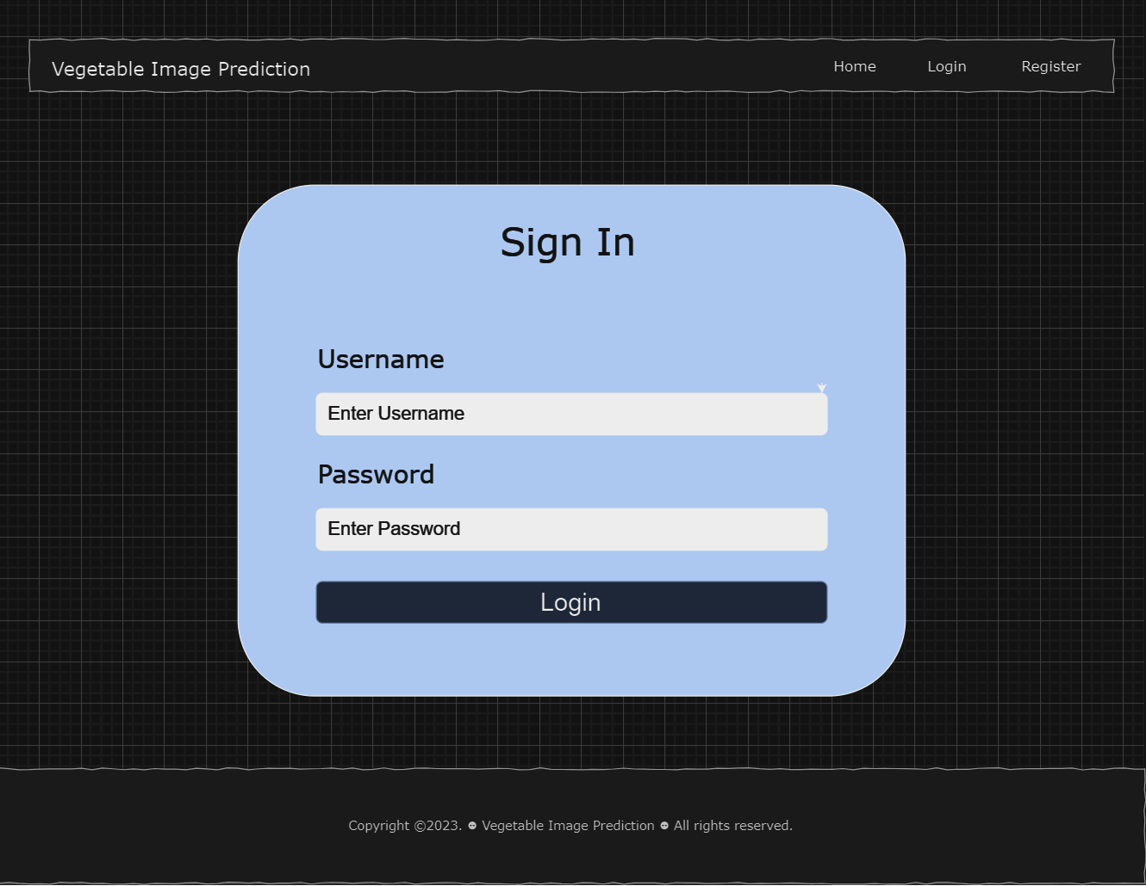
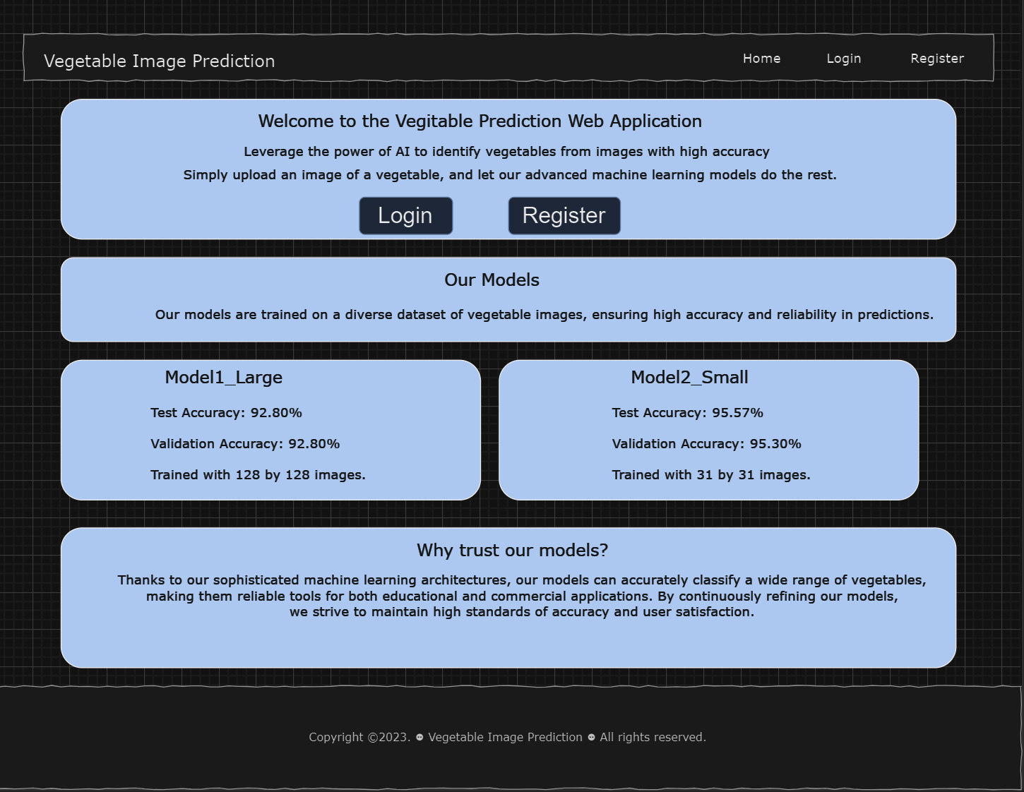
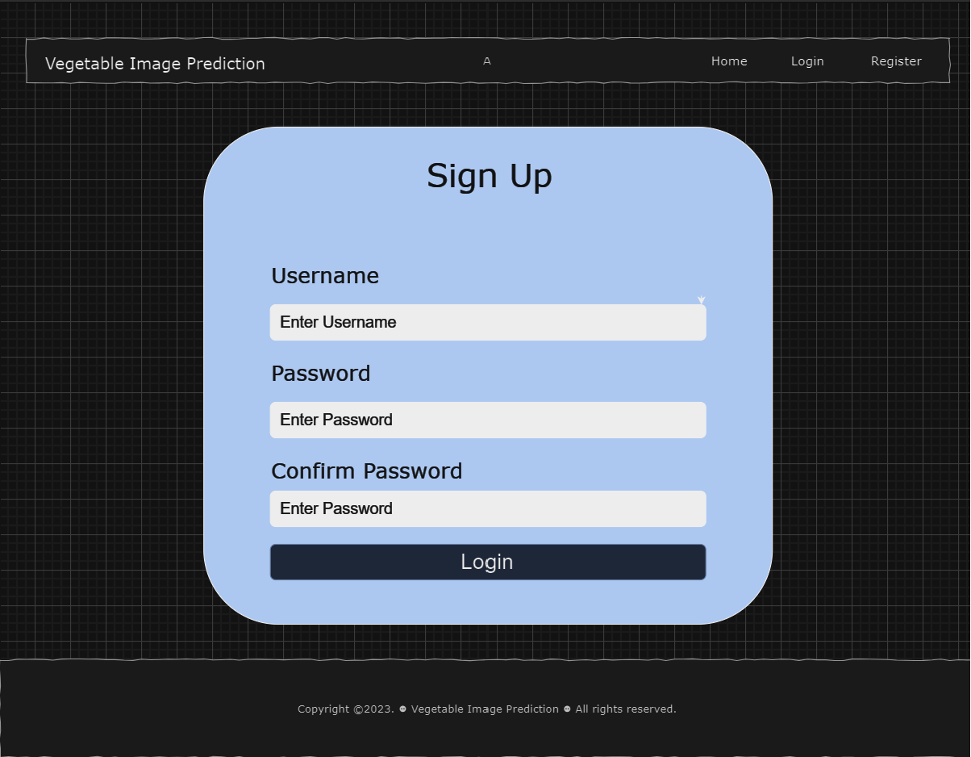
WireFrame
login.html
index.html
register.html

Slide 8
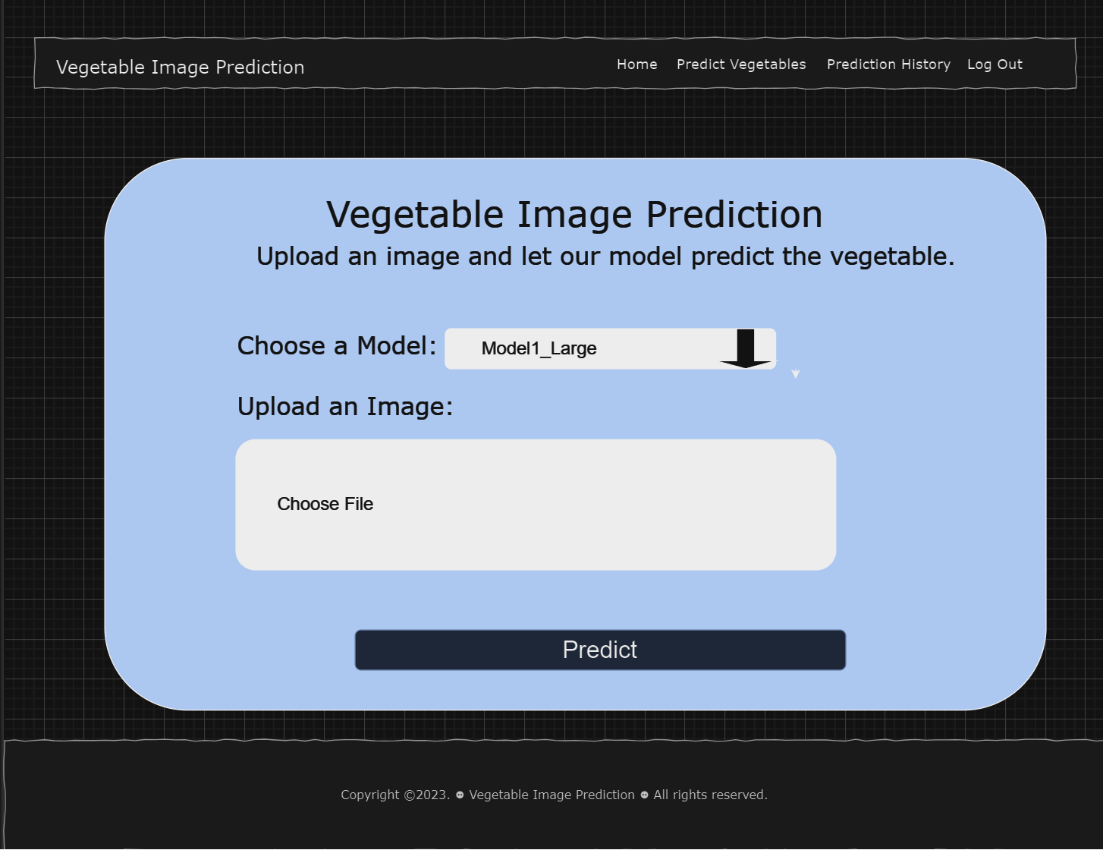
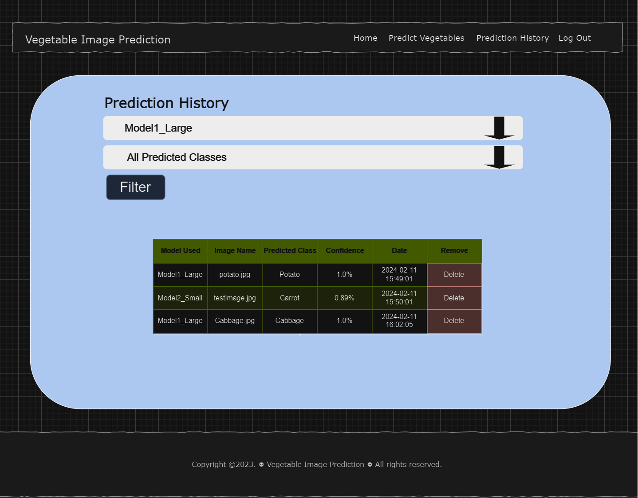
WireFrame
predict.html
predictionHistory.html

Slide 9
Branch 1 (DLModel_branch)
DLModel_branch will focus on the development and optimization of Deep Learning models. We will then containerize the 2 models into a single Docker container before deploying to Render.com.
Upon Model development and after improvement this are the results for our best 2 models:
Final Model 1 (Trained on 31 by 31 images):
Test Accuracy: 95.57%
Validation Accuracy: 95.30%
Final Model 2 (Trained on 128 by 128 images):
Test Accuracy: 92.80%
Validation Accuracy: 92.80%
Deployment
Save models weights
Containerize 2 models into 1 container
Local deployment testing
Create Dockerfile
Deploy model on Render.com

Slide 10
Branch 1 (DLModel_branch)
Deployment
Save models weights First, I will first save the weights of the best performing 128x128 and 31x31 model.
Containerize 2 models into 1 container To containerize the 128x128 and 31x31 models into a single Docker container, I used the following command: docker run --name digit_server_CA2 -p 8501:8501 -v "C:/Users/kieny/Documents/Y2S2 - DAAA/DOAA CA2/ca2-daaa2b05-2222291-tohkienyu-main-img_classifier (1)/ca2-daaa2b05-2222291-tohkienyu-main-img_classifier/img_classifier:/models/img_classifier" -v "C:/Users/kieny/Documents/Y2S2 - DAAA/DOAA CA2/ca2-daaa2b05-2222291-tohkienyu-main-img_classifier (1)/ca2-daaa2b05-2222291-tohkienyu-main-img_classifier/img_classifier/models.config:/models/models.config" -t tensorflow/serving --model_config_file=/models/models.config
Local deployment testing After containerizing the 2 models, I deployed them locally and did unit testing to ensure it is functioning and verifying that the models were correctly loaded and able to make predictions with the expected level of accuracy.

Slide 11
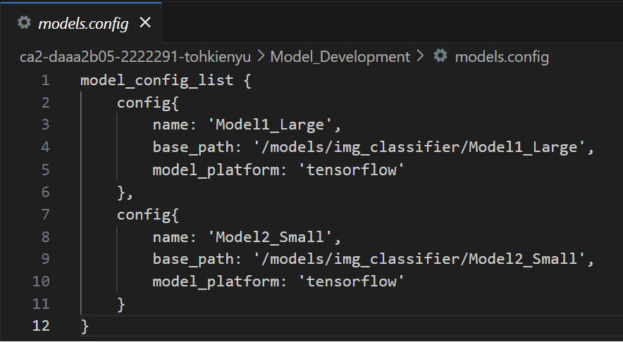
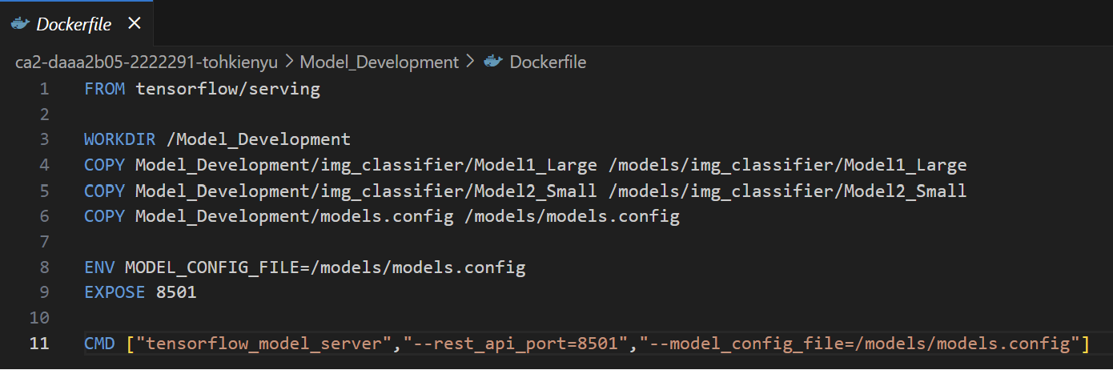
Branch 1 (DLModel_branch)
Deployment
Dockerfile For Deployment I then created a Dockerfile which contains the instructions for setting up the Tensorflow serving environment, copying the model weights and configuration file into the container and commands in order to run the Tensorflow model server.
Model Development on Render Finally, I deployed the Docker container to Render.com. This ensures that the models were accessible via a web interface. Upon deployment, I conducted tests to ensure that the models were operational and responding as expected.
models.config:
Dockerfile:

Slide 12
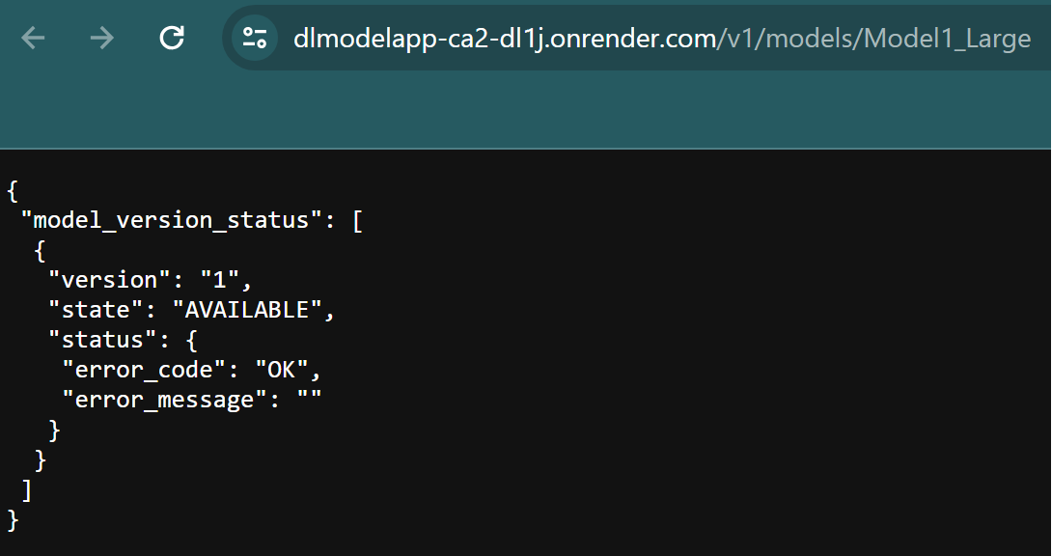
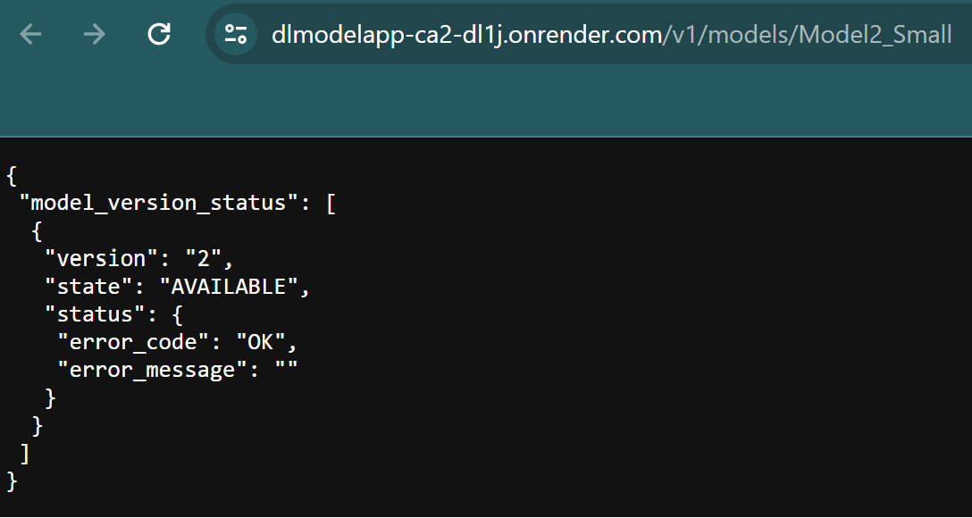
Branch 1 (DLModel_branch)
The model has been successfully deployed and now accessible at the following URL:
Model1_Large(128x128):
https://dlmodelapp-ca2-dl1j.onrender.com/v1/models/Model1_Large
Model2_Small(31x31):
https://dlmodelapp-ca2-dl1j.onrender.com/v1/models/Model2_Small

Slide 13
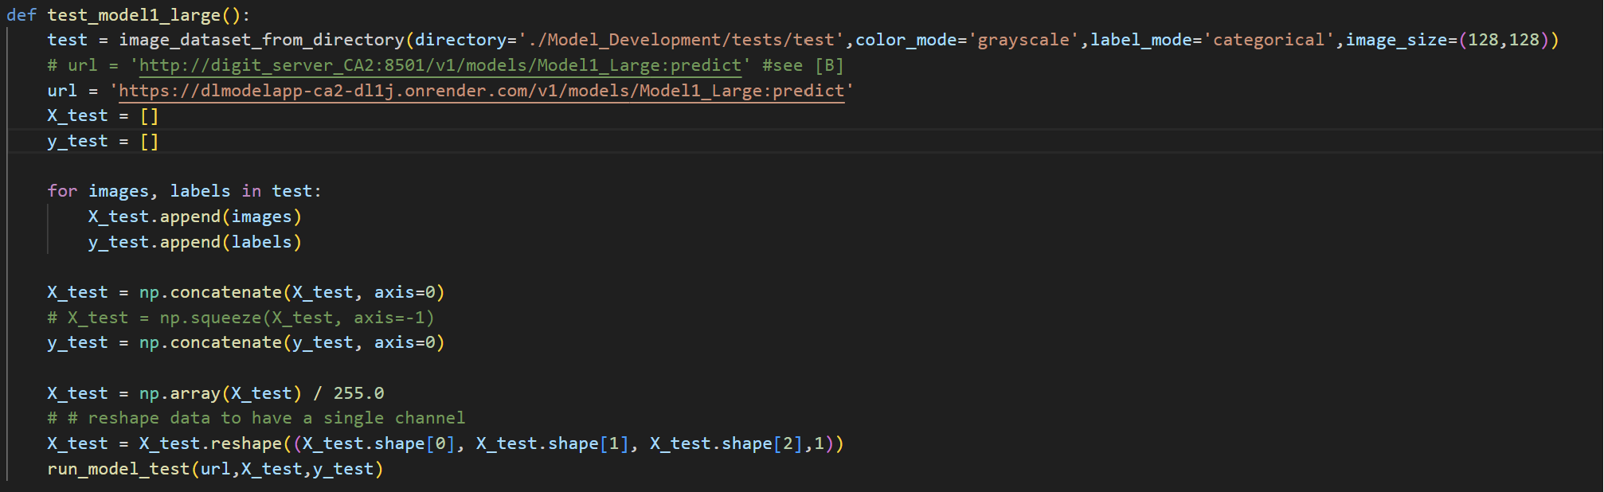
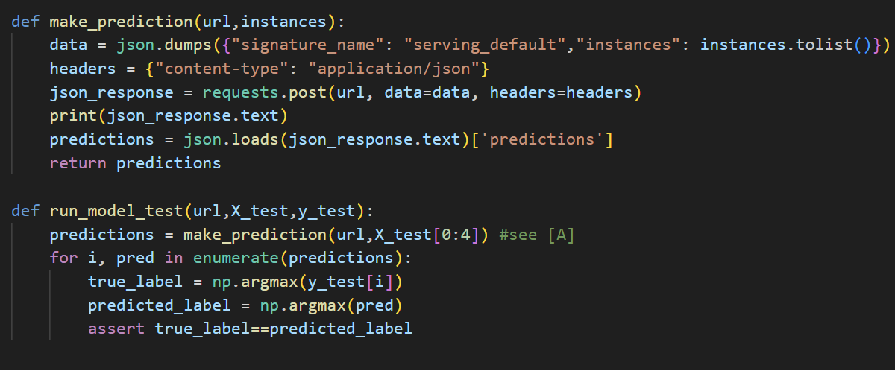
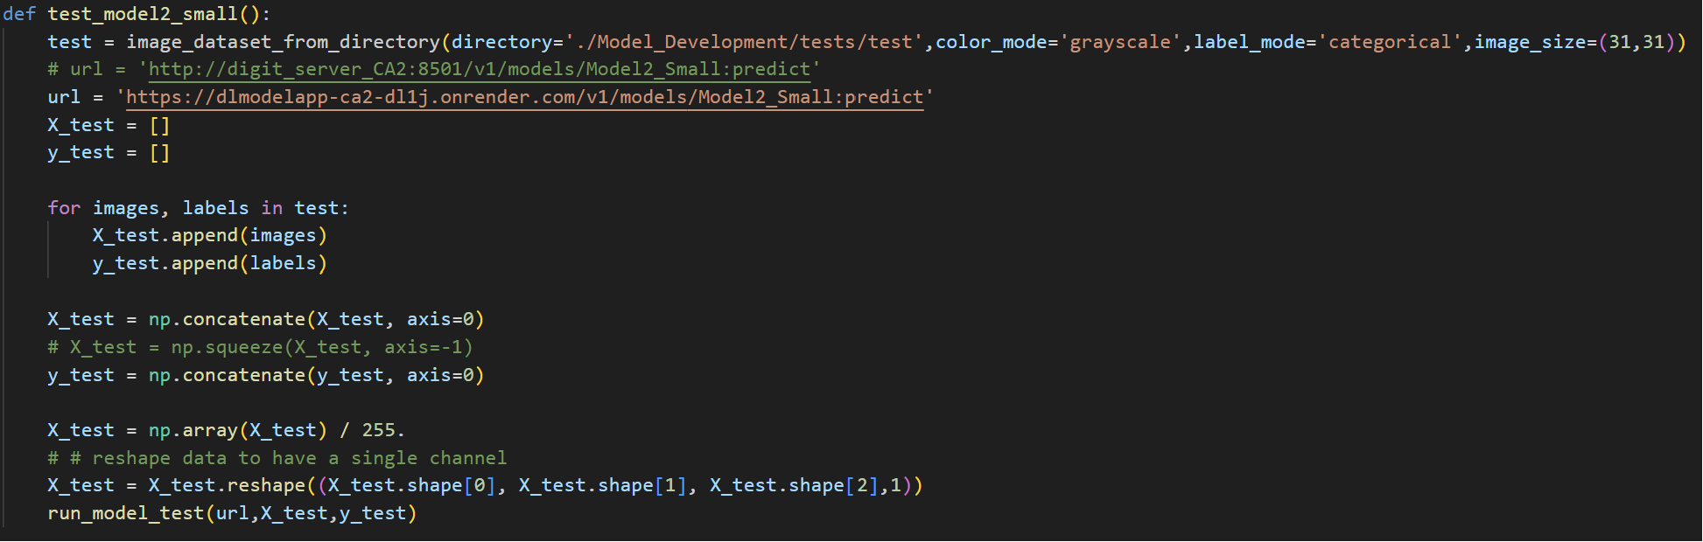
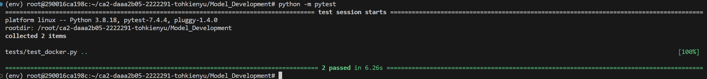
Branch 1 (DLModel_branch)
Testing was done to ensure both models were operational and responding as expected.
Test Results:

Slide 14
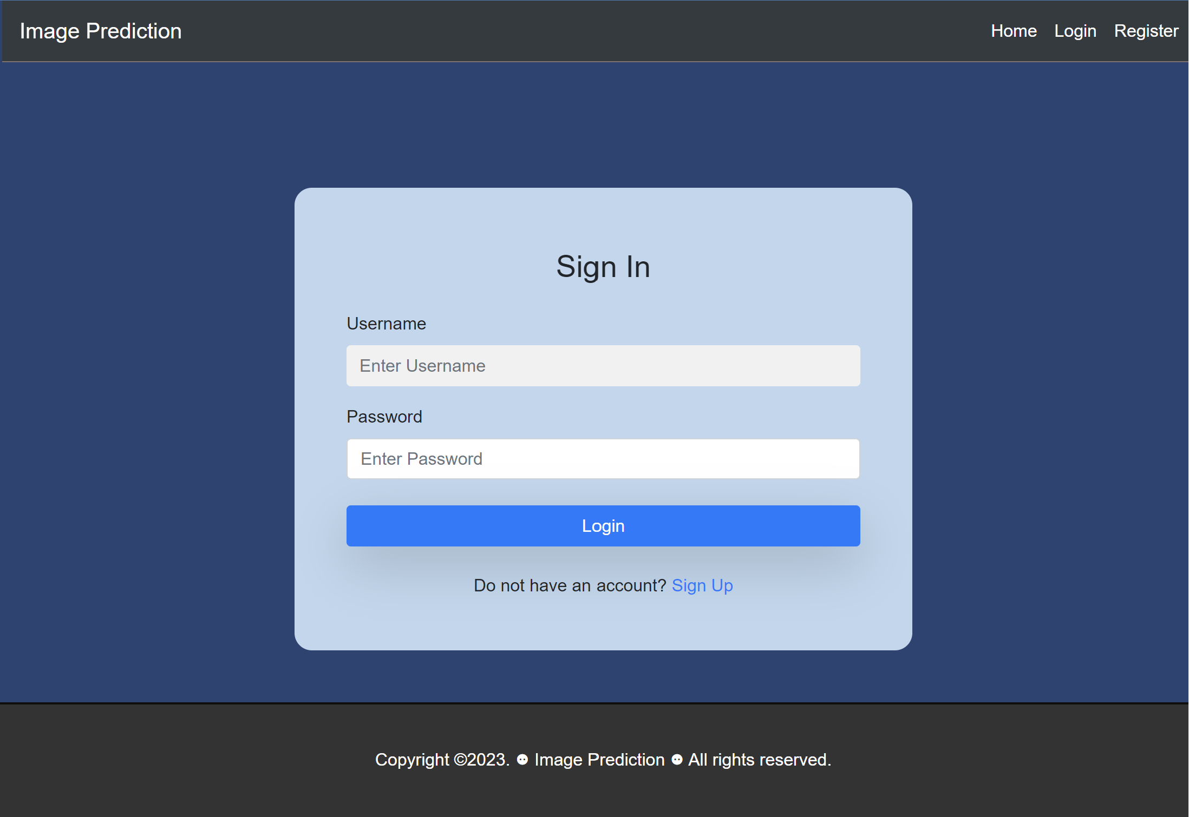
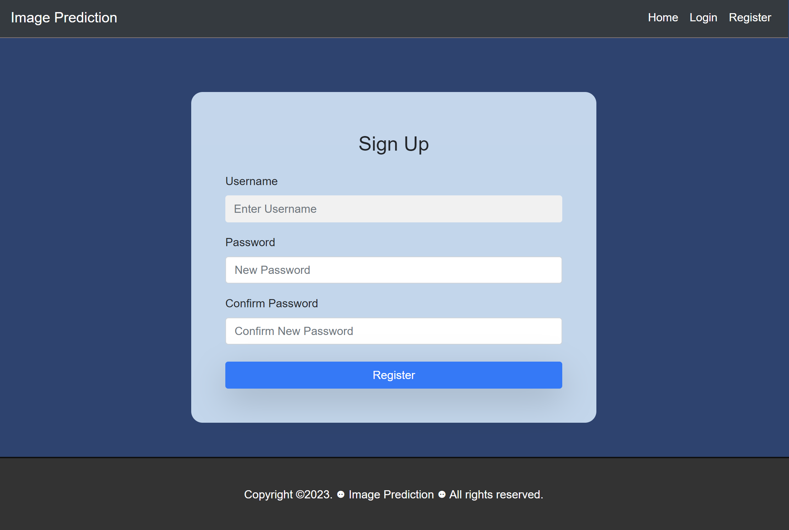
Branch 2 (DLWebApp_branch)
DLWebApp_branch focuses on integrating both deep learning models into the web application and enable users to upload an image before making a prediction.
This branch is also tasked on the designing of user interface which includes features such as home, login, registration, predict and prediction history page. Unit testing will also be done on this branch to ensure the web application’s functionality and reliability.
login.html
register.html

Slide 15
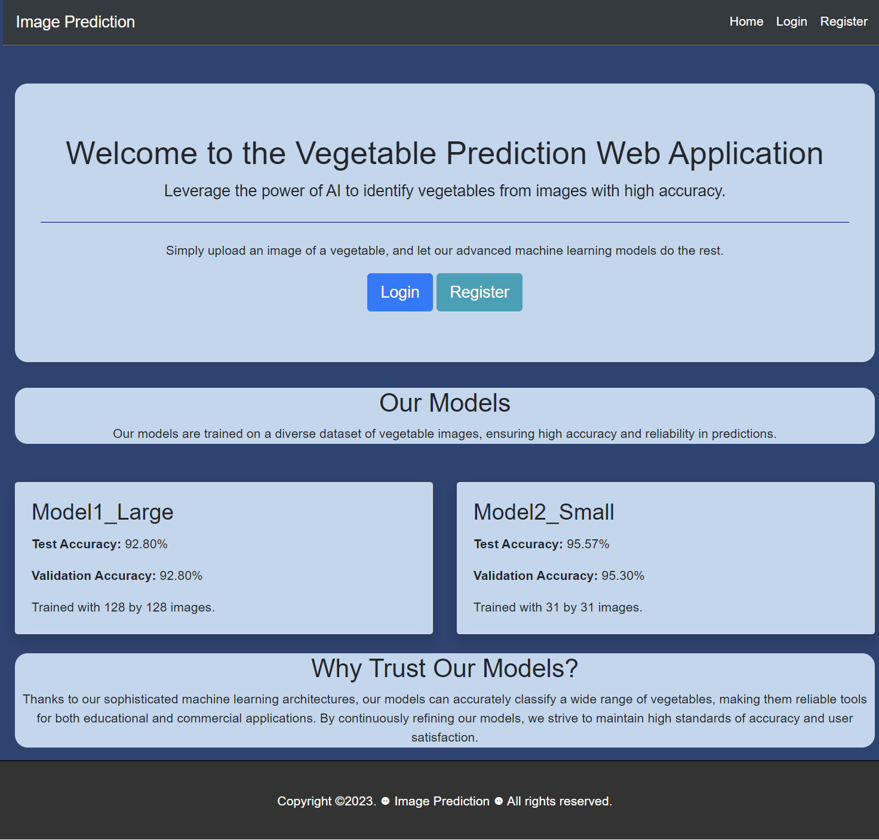
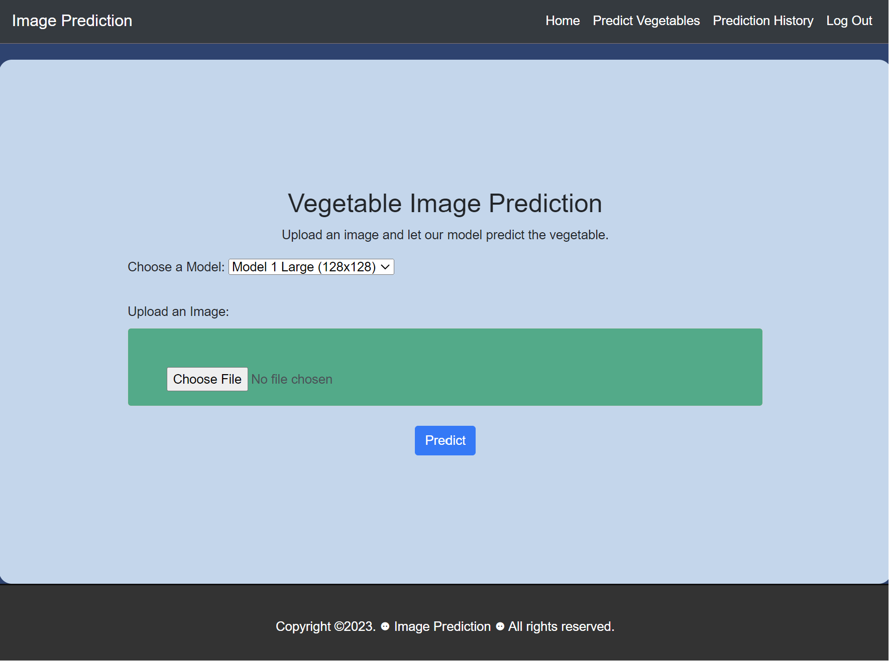
Branch 2 (DLWebApp_branch)
predict.html allows user to switch between model 1 and model 2 of their choice before making a prediction
index.html
predict.html

Slide 16
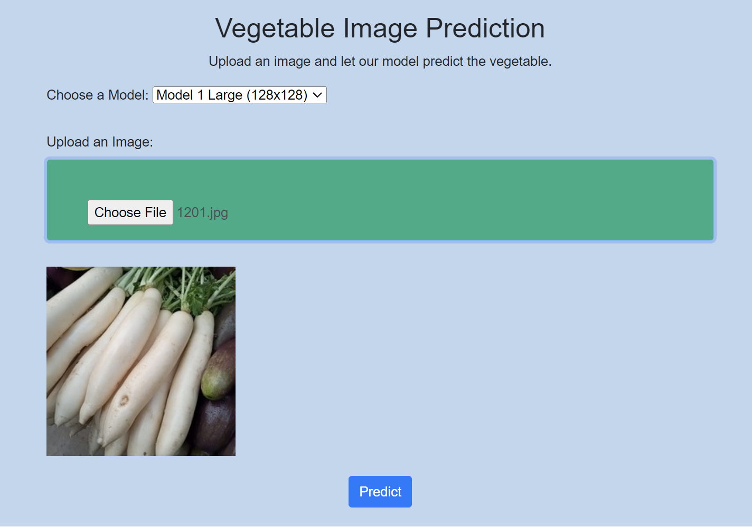
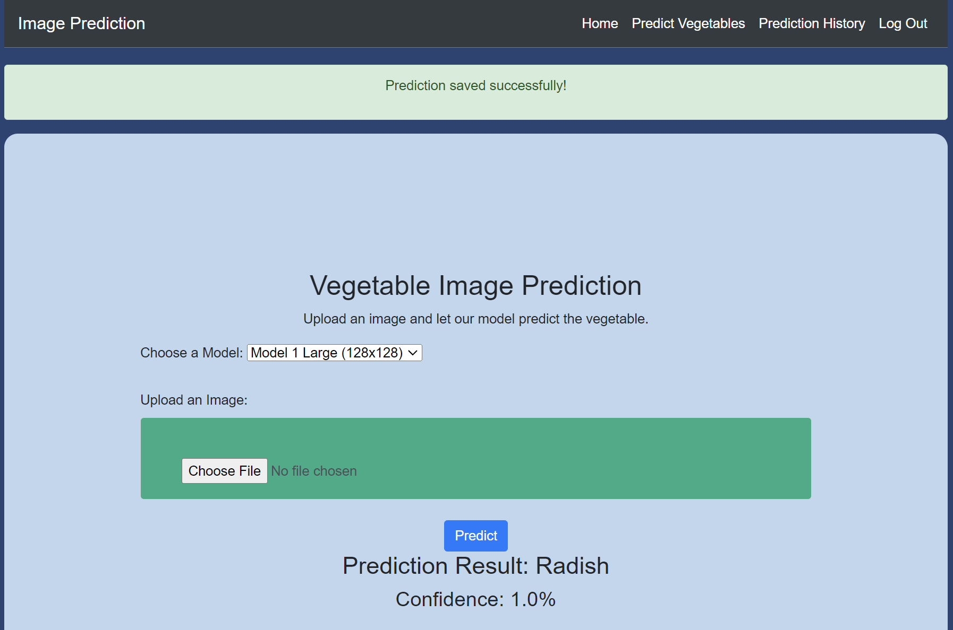
Branch 2 (DLWebApp_branch)
For example, a user uploads a picture of a radish and press ‘Predict’ and it will return the prediction result and the confidence of the model’s prediction

Slide 17
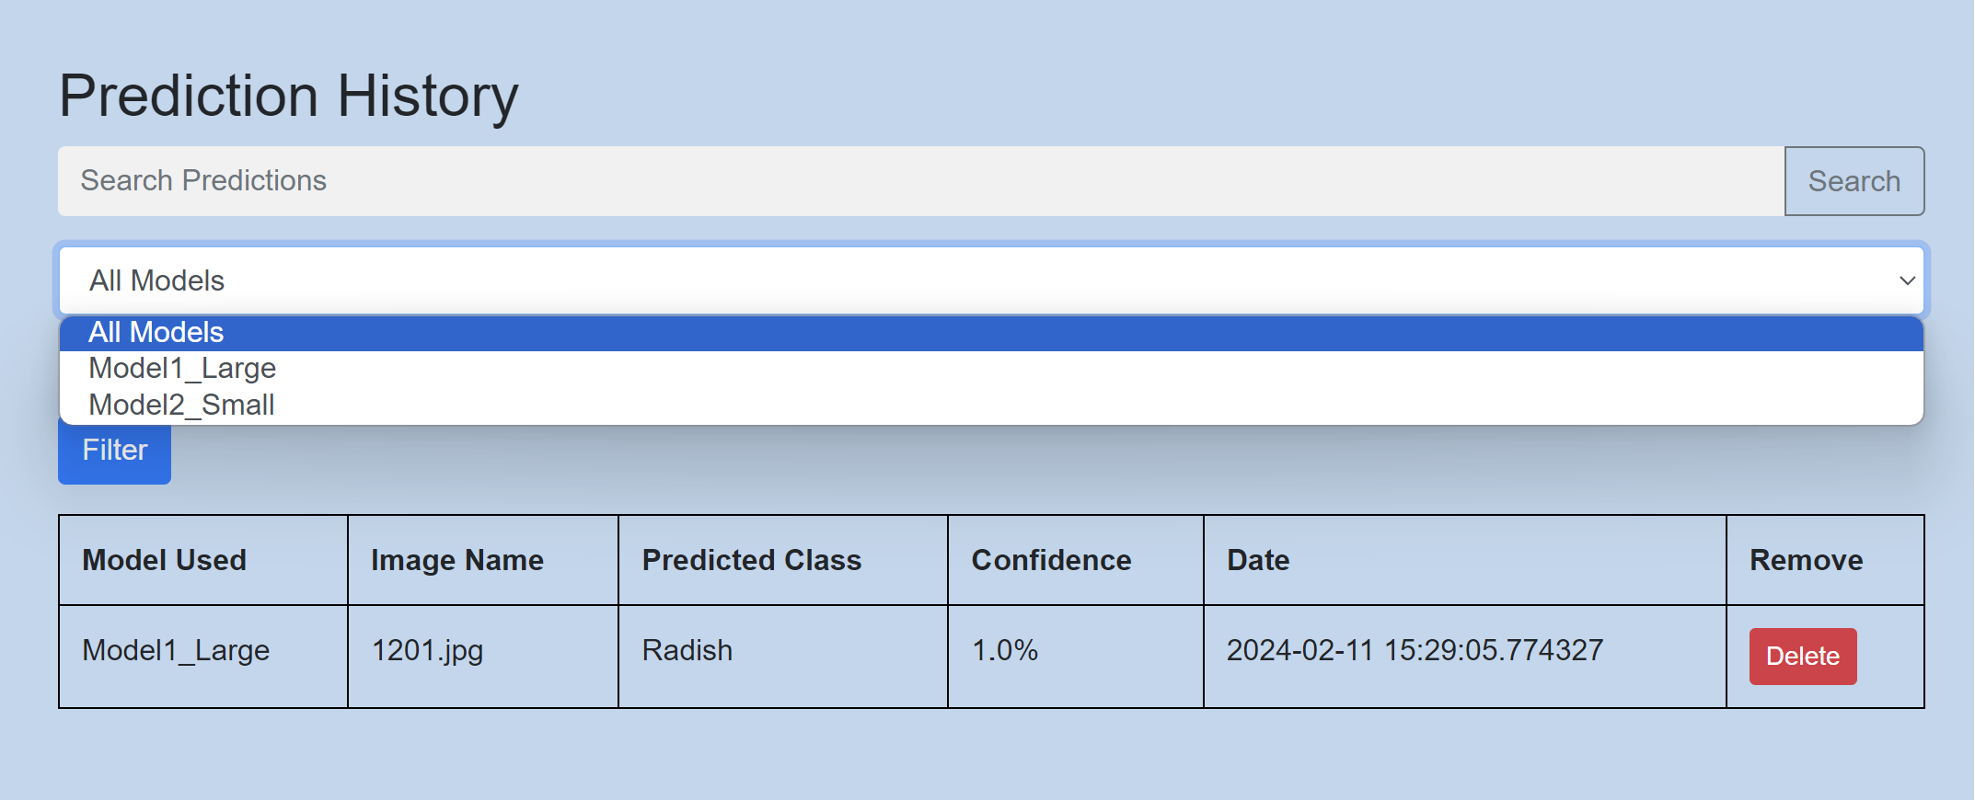
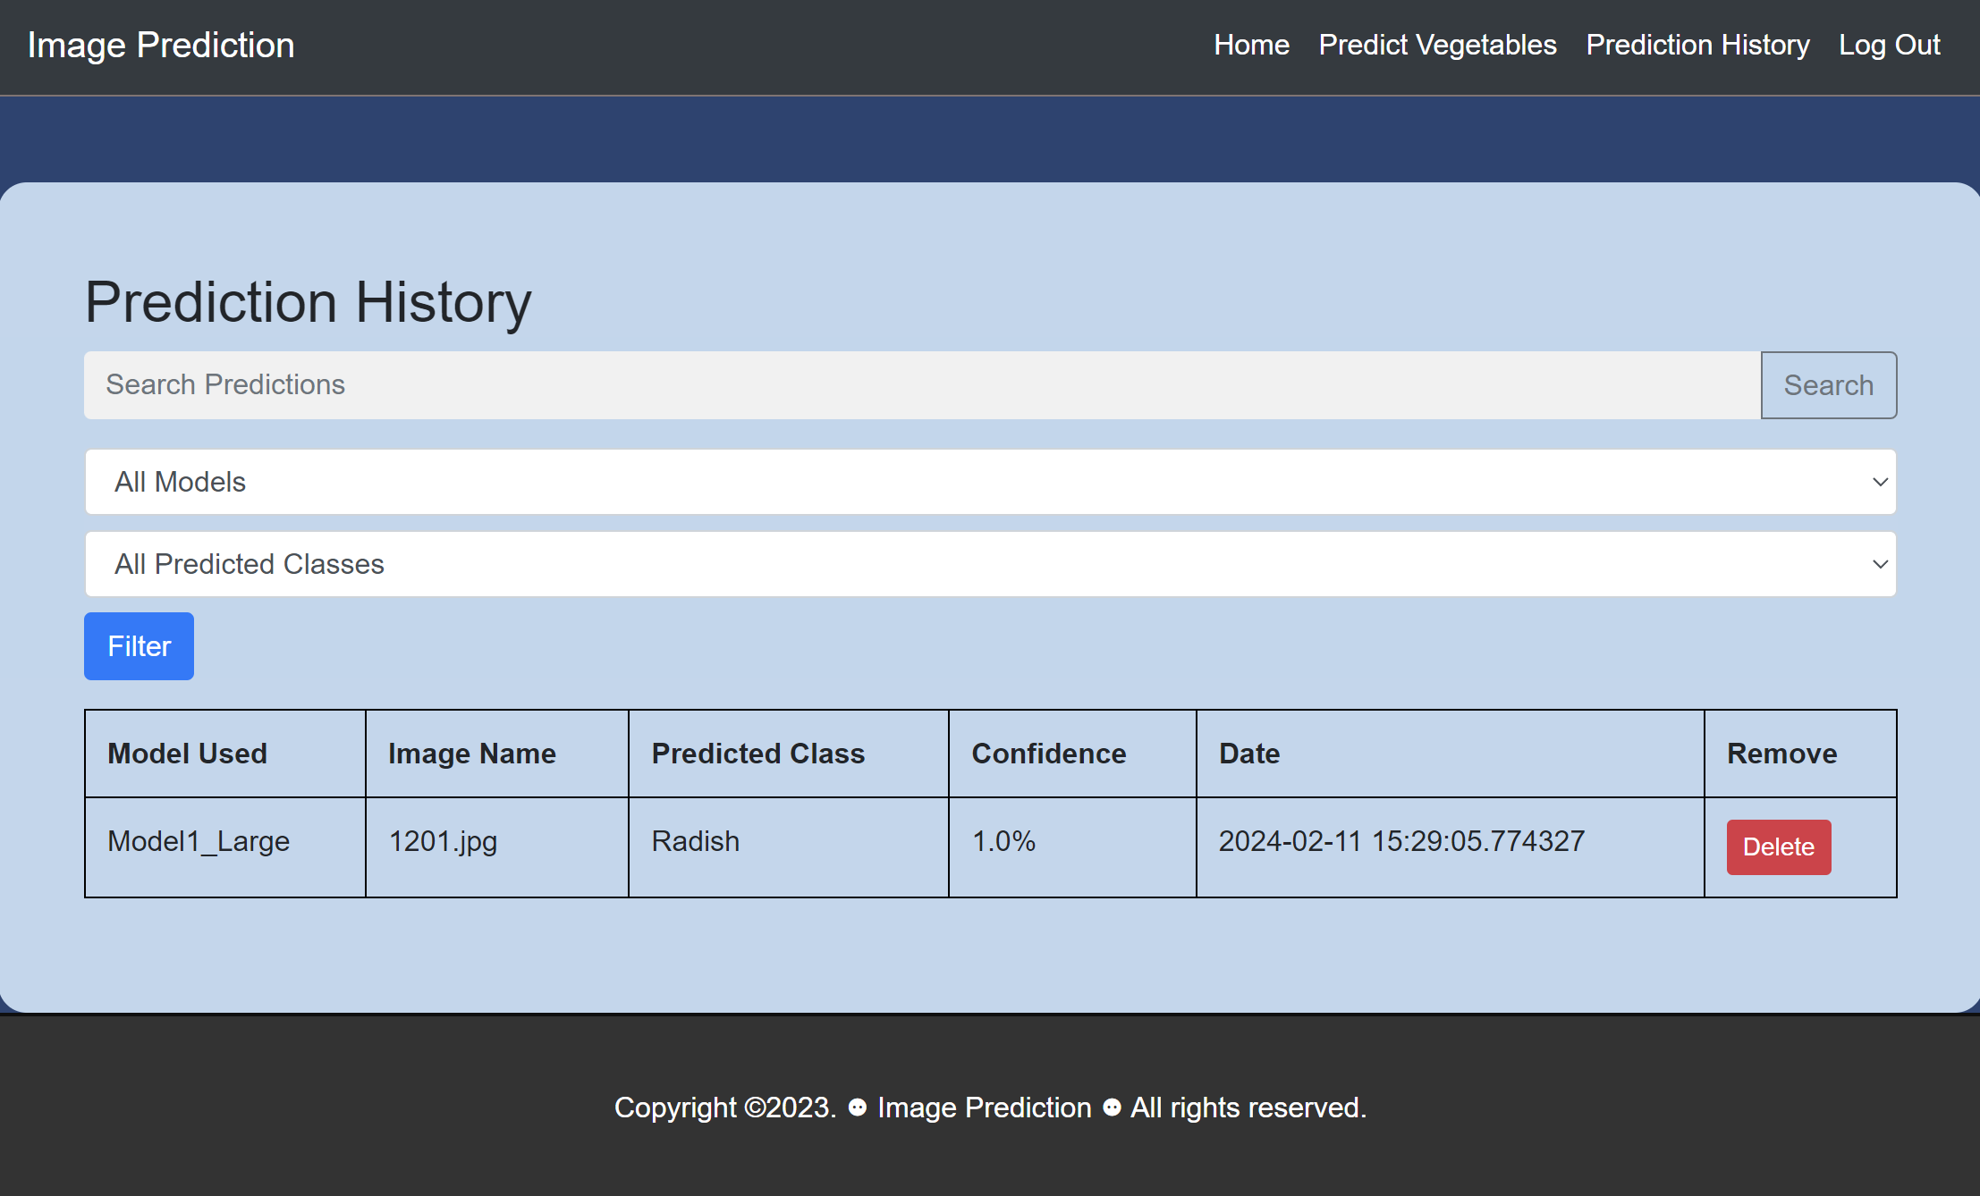
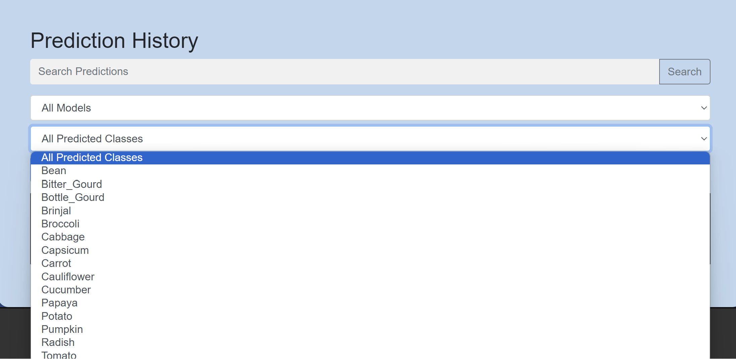
Branch 2 (DLWebApp_branch)
The prediction history page will record each predictions made by the user. Additionally, will then save the prediction. The prediction history page also offers capabilities for users to filter and search for results based on the model used and specific classes user wants to display through the use of the search and filter button. Users can also delete specific records.
predictionHistory.html

Slide 18
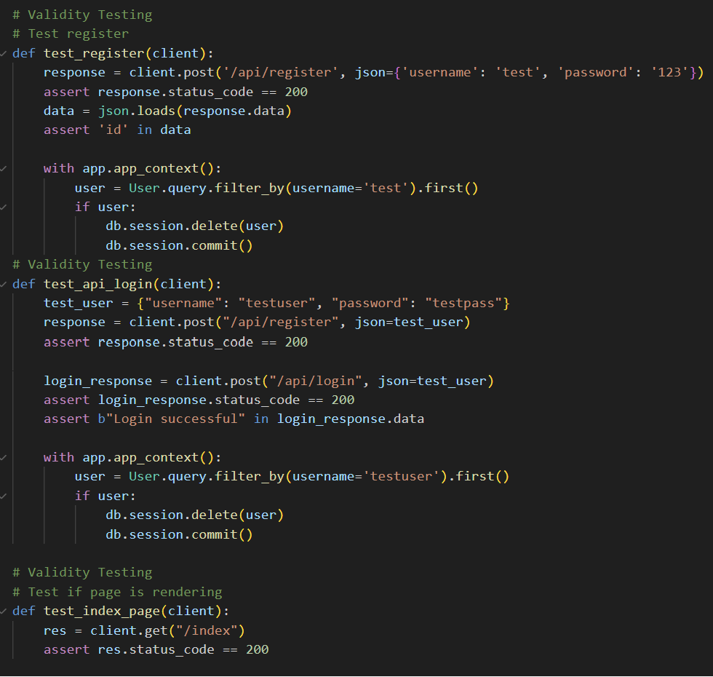
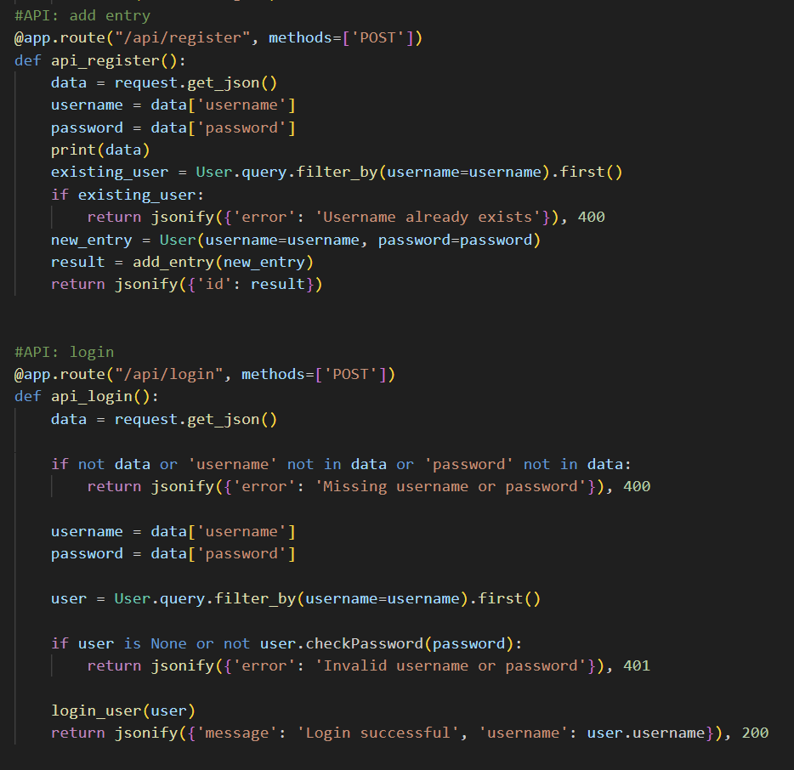
Branch 2 (DLWebApp_branch)
Unit Testing
Validity testing was done to make sure the registering and logging in of user is functioning correctly. This provides a seamless experience for users

Slide 19
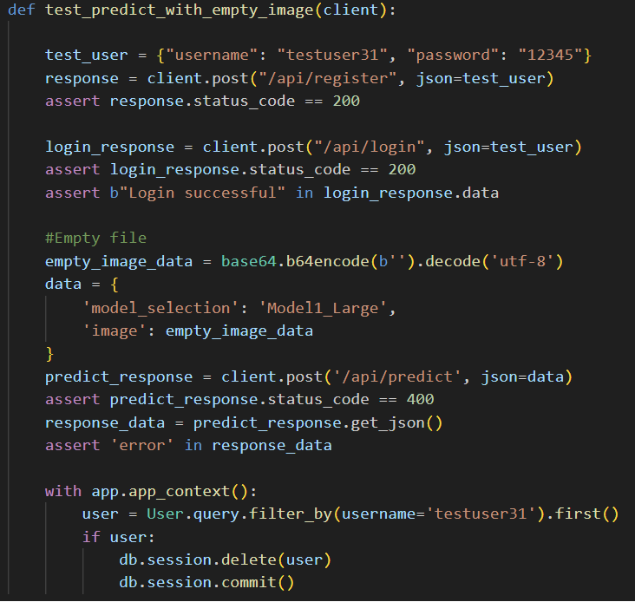
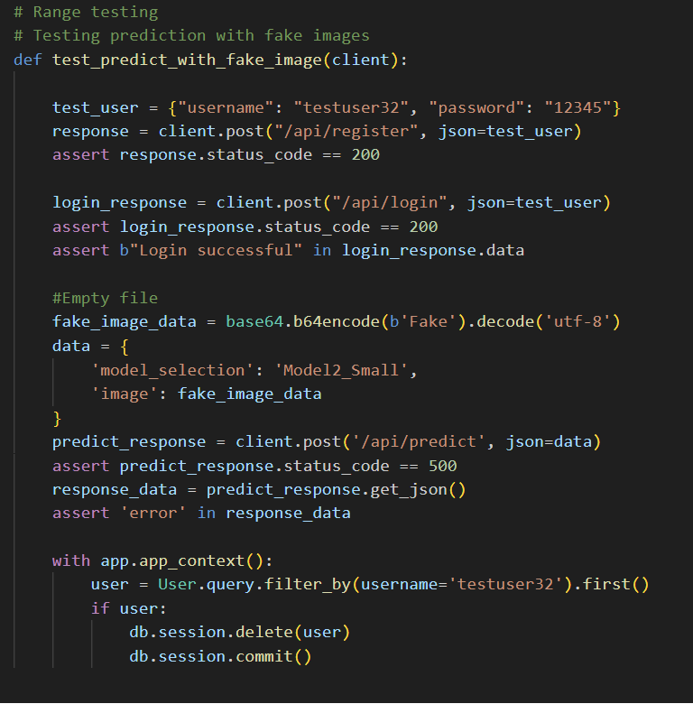
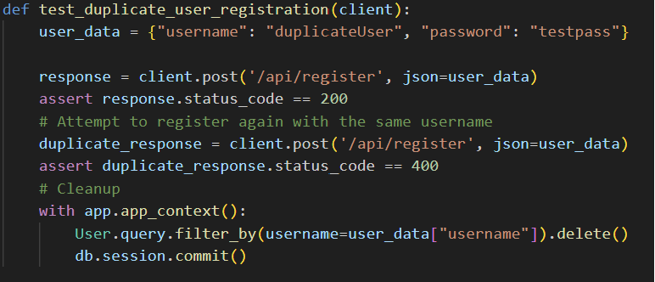
Branch 2 (DLWebApp_branch)
Unit Testing
Expected failure testing was done on Registration API to ensure the application handles duplicate username registration correctly.
- Passes when unique username is inserted into the database
- Expected failure when username is not unique
Range testing was done to ensure that the web application can handle empty image or any invalid file given by user.

Slide 20
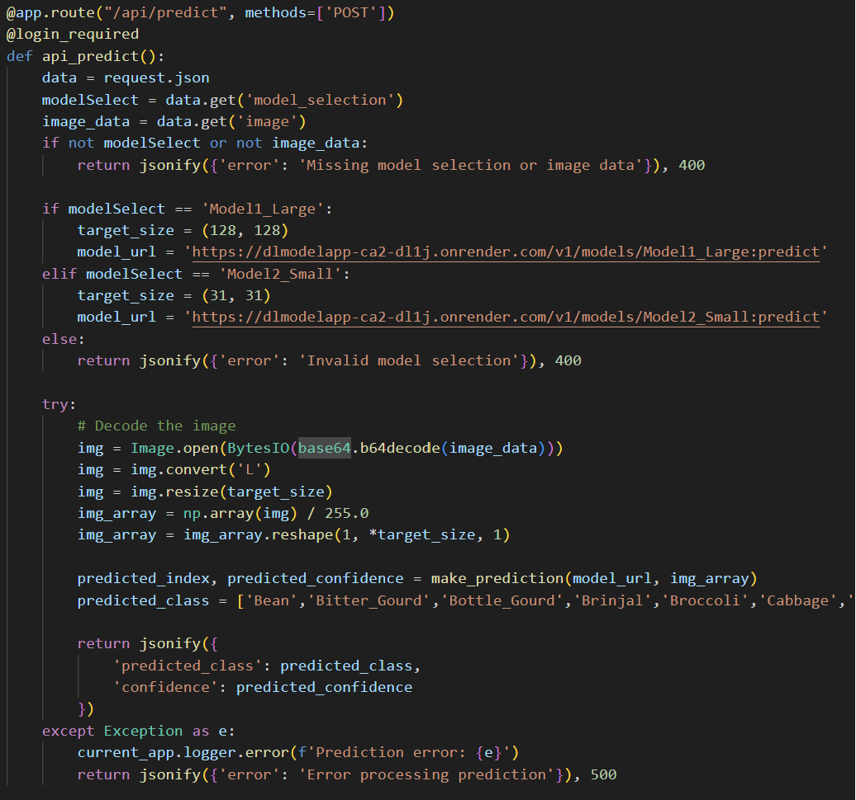
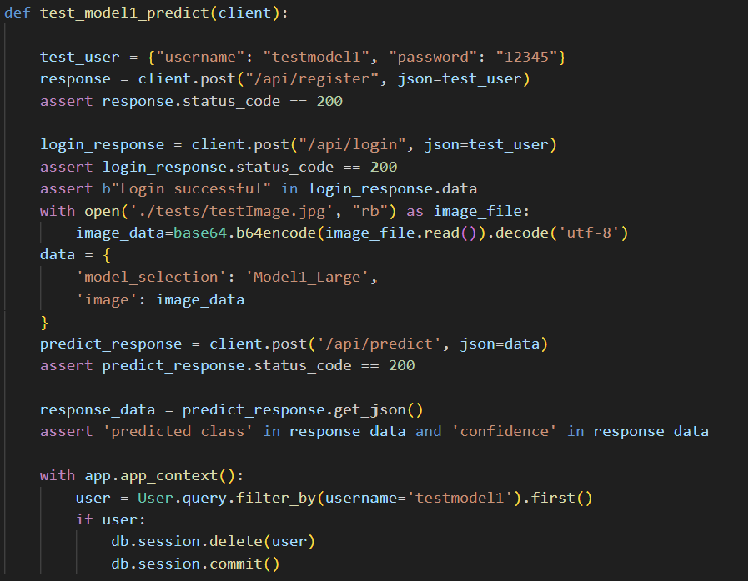
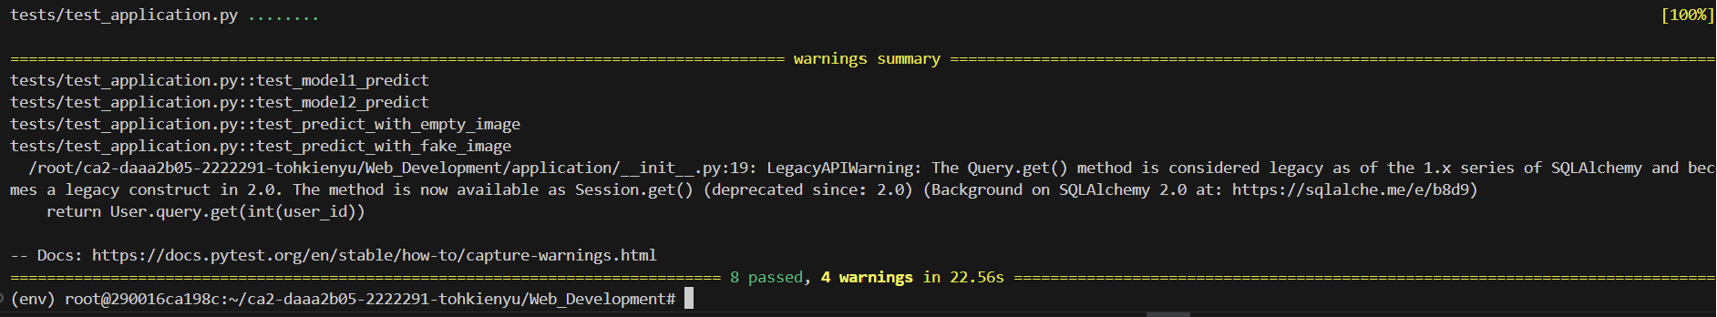
Branch 2 (DLWebApp_branch)
Unit Testing
Validity and Consistency testing was done to ensure the model operates correctly. This tests ensure that both model are able to consistently correctly produce predictions, thus verifying the application’s functionality in handling prediction requests accurately.
Summary of tests

Slide 21
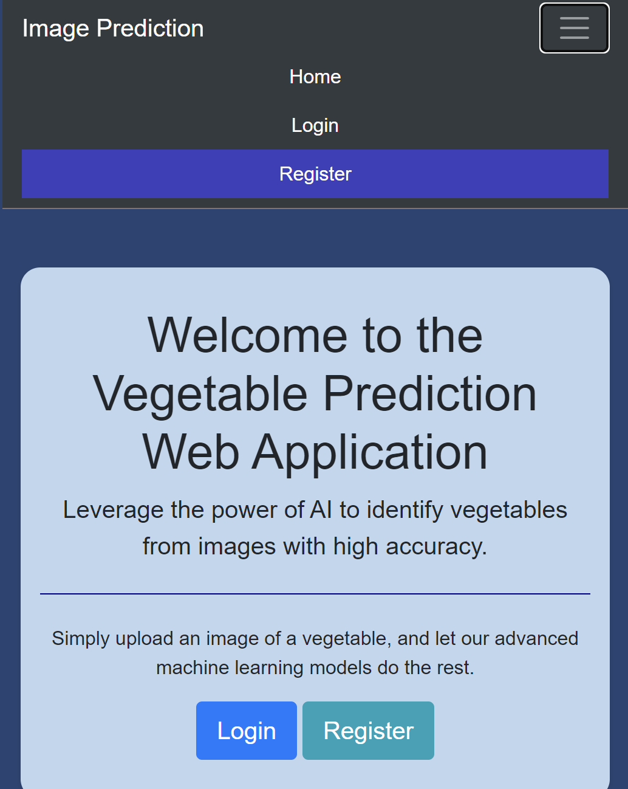
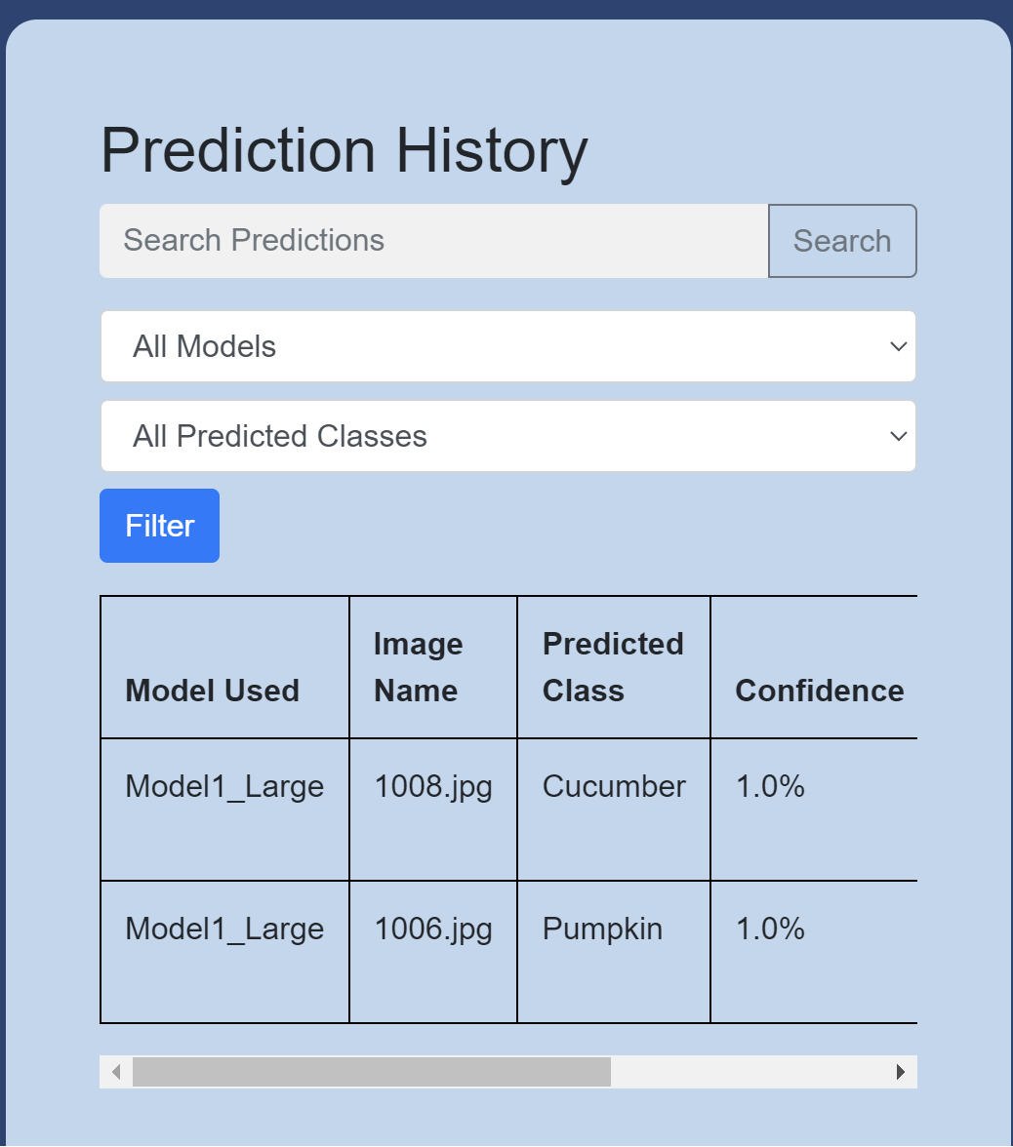
Branch 3 (improveUI_branch)
Responsive Web Application (Catered for smaller and larger devices)
For example: Dropdown menu was added for smaller devices and hover animations. History table was also made responsive with scrollbar added.

Slide 22
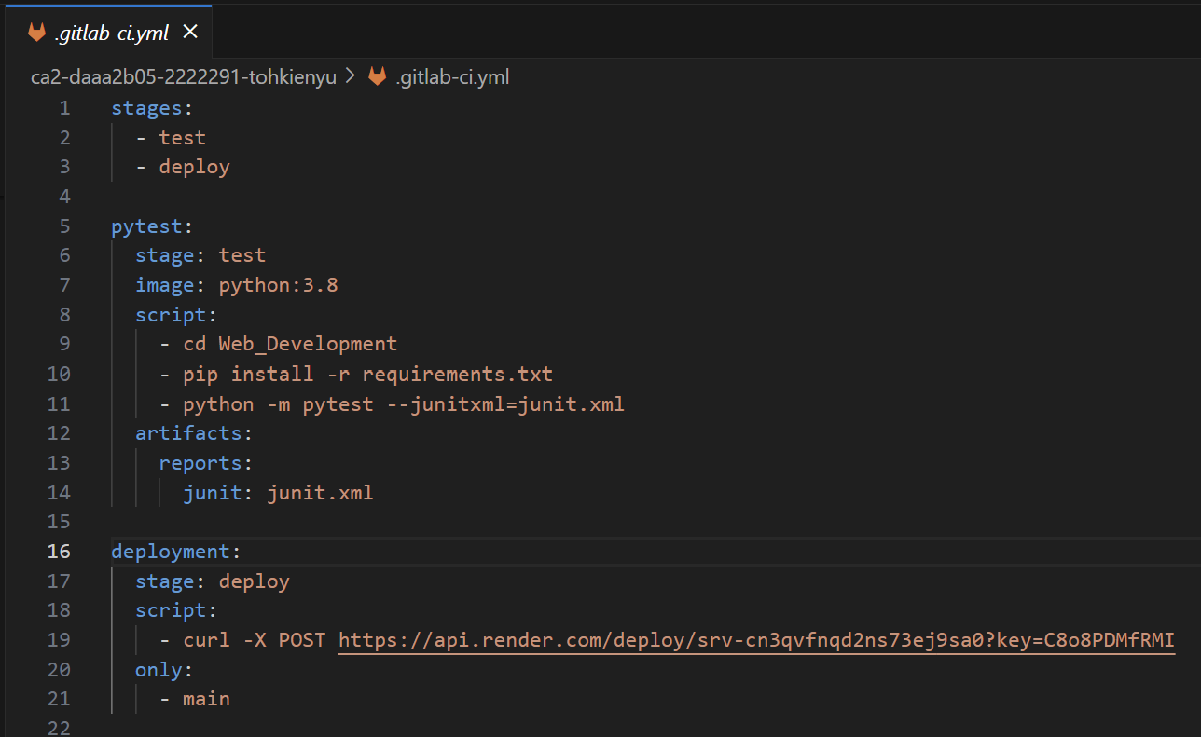
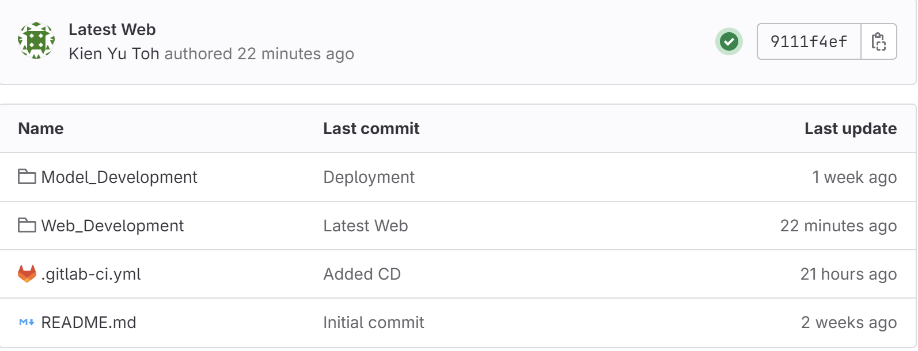
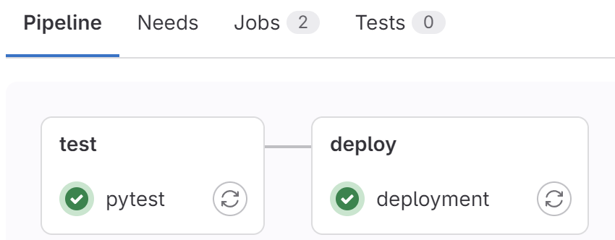
Branch 4 (CICD_branch)
Branch 4 integrates the CI/CD pipeline configuration to automate the testing and deployment process. This setup ensures that every change is automatically tested, and builds are successful before it gets deployed which ensures a efficient workflow.

Slide 23
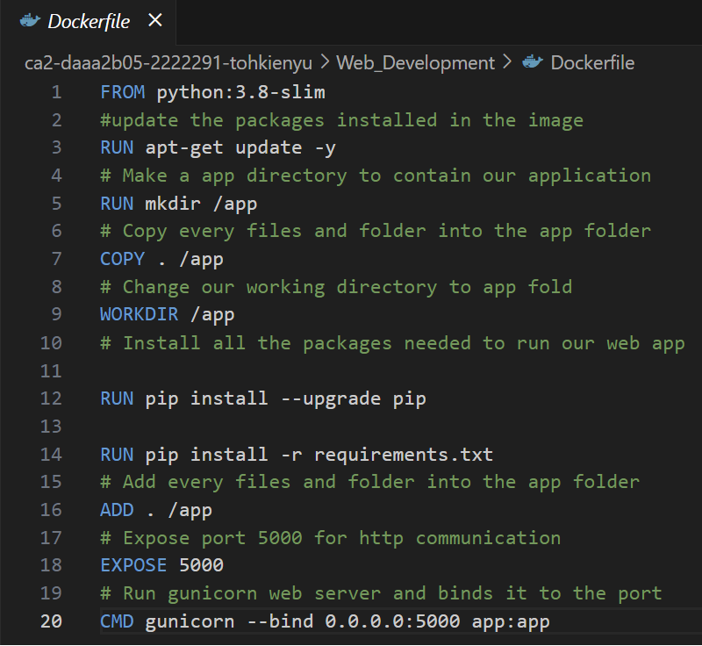
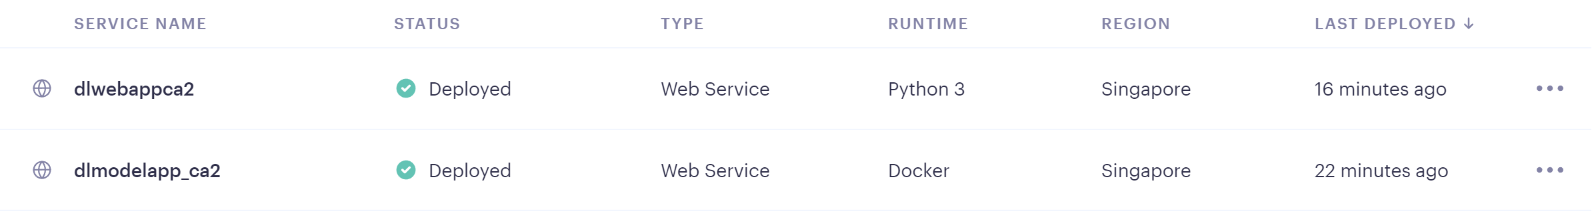
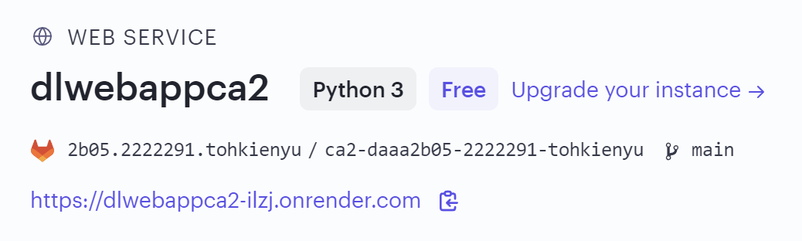
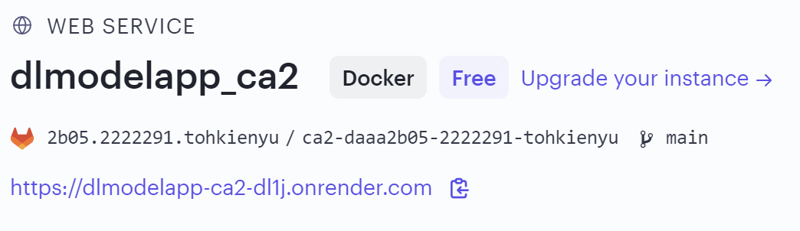
Internet Deployment
Dockerfile for web:
Render was used to deploy the web application
Final Web Application:
https://dlwebappca2-ilzj.onrender.com/
Models:
https://dlmodelapp-ca2-dl1j.onrender.com/v1/models/Model1_Large
https://dlmodelapp-ca2-dl1j.onrender.com/v1/models/Model2_Small

Slide 24
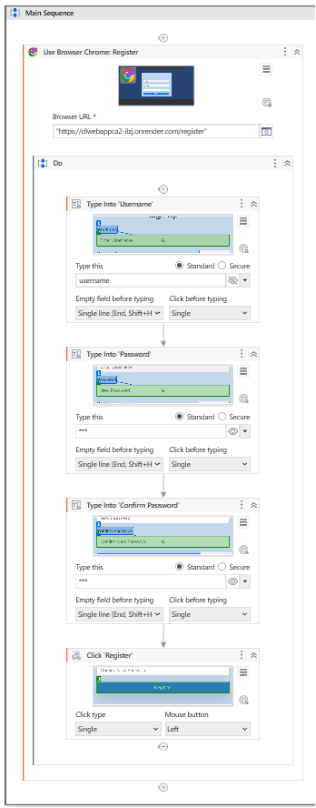

RPA
UIPath was used to automate:
Logging in of credentials
Registering of new users
This allows us to execute login and register sequence automatically and reduces these repetitive and time consuming tasks

Slide 25
Thank You

